Slide 1

Ecommerce purchase Intention prediction
Using machine learning and data mining
Harsanbruno Maria Joseph Esuraj – 20065575
Gunasekhar vasireddy – 20061005
Ramraj Kulavayal - 20056189

Slide 2



Business Understanding and Objectives
Business Context In the highly competitive e-commerce industry, a large percentage of website visitors leave without making a purchase. Identifying visitors most likely to convert can help businesses focus marketing efforts, reduce cart abandonment, and increase revenue.
Business Goal Develop a predictive system to classify website sessions as likely to purchase or unlikely to purchase based on user behavior and session attributes.
Project Objectives
Analyze visitor behavior using historical session data.
Identify key features that influence purchasing decisions.
Build and evaluate machine learning models to predict purchase intent.
Provide actionable insights for marketing and personalization strategies.
5

Slide 3

Dataset Overview
Name: Online Shoppers Intention Dataset
Description: Data on session-level behavior gathered by an online web shop.
Records Total: 12,330
Number of Features: 18 (17 independent, 1 target)
Type: CSV File
Source: UCI Machine Learning Repository
Description of Features
Administrative / Administrative Duration: How many and total time of administrative related pages.
Informational / Informational Duration: The count of pages and the time on informational pages.
Product Related / Product Related Duration: The amount and the amount of time spent on the pages relating to the products.
Bounce Rates: Percentage of visitors that leave immediately after viewing one page.
Exit Rates: Probability of leaving the site out of a definite page.
Page Values: The average of page values regarding conversions.
SpecialDay: Physical closeness of the session to a special shopping day (i.e., Valentine Day).
Month: Month the session occurred in.
Operating System, Browser, Region, Traffic Type: Technical and geographic session information.
Visitor Type: Difference between a returning or a new customer.
Weekend: Did the session take place at the weekend.
Revenue (Target Variable): Boolean — indicates whether the session led to a purchase (True/False).
5

Slide 4
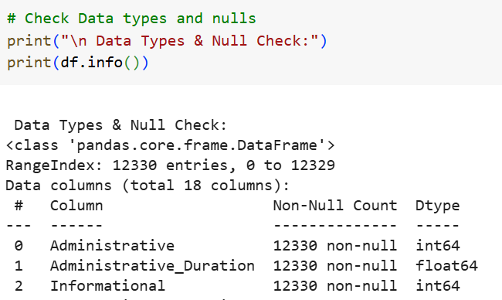
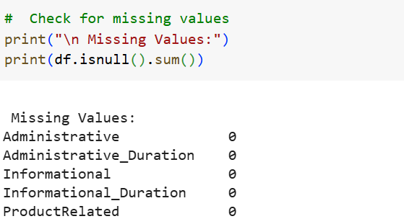
Data Cleaning & Preparing for Visualization
1. Data Inspection
Checked dataset shape and column types.
Verified number of missing values.
Reviewed unique value counts for each feature.
2. Handling Missing Data
No missing values found in dataset.
No imputation required.
3. Data Type Adjustments
Converted categorical variables to appropriate formats for analysis.
Verified numeric variables for correct data types.
4. Outlier Detection
Checked for unusual values in numeric features.
No extreme outliers affecting analysis found.
5. Split and train
train and test the data 80% training 20% test
6. Final Preparation
Dataset confirmed clean and ready for visualization.
All features properly labeled and structured.
5

Slide 5
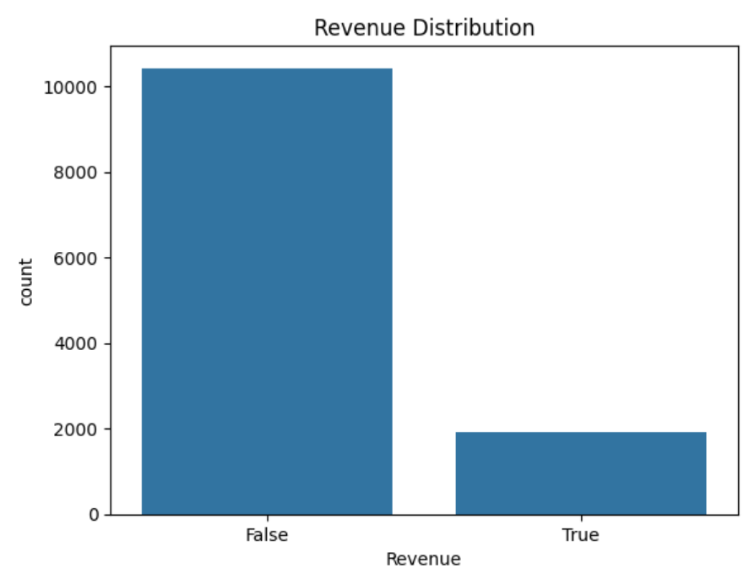
Exploratory Data Analysis (EDA) - Revenue Analysis
The analysis of the target variable Revenue (True/False) reveals the purchase behavior of shoppers:
False: 84.53% of the sessions did not result in a purchase.
True: Only 15.47% of sessions resulted in a purchase.
This significant disparity shows that while most online shoppers visit the website and add items to their cart, only a small portion complete the purchase. Possible reasons for this behavior include:
Comparison shopping
Indecision regarding pricing
Distractions during the checkout process
Given the imbalanced dataset, it's crucial to consider additional metrics like precision, recall, and F1-score along with accuracy. These metrics ensure the reliable prediction of the minority class (True - purchase).
5

Slide 6



Models Implemented In Python
1. Logistic Regression
Simple, interpretable binary classification model.
Provides a baseline performance benchmark.
2. Decision Tree
Non-linear, rule-based model.
Identifies key features influencing purchase decisions.
3. Random Forest
Ensemble of multiple decision trees.
Reduces overfitting and improves accuracy.
4. Multi-Layer Perceptron (MLP)
Basic neural network architecture.
Captures complex non-linear patterns.
5. Support Vector Machine (SVM)
Effective in high-dimensional spaces.
Uses kernel functions for non-linear separation.
6. XGBoost
Gradient boosting algorithm optimized for speed and performance.
Performs well on imbalanced datasets.

Slide 7
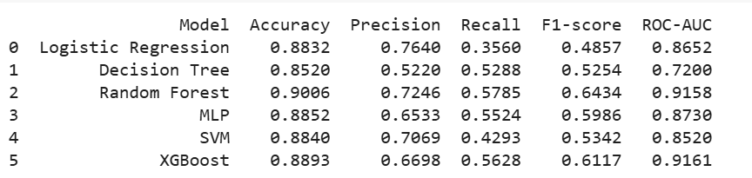
Python model Result
Model Accuracy Comparison
Top Performers:
Random Forest: 90.06% – Highest accuracy, indicating reliable predictions.
XGBoost: 88.93% – Second highest, showing solid performance.
MLP: 88.52% – Strong accuracy, similar to XGBoost, but slightly lower.
Moderate Performers:
SVM: 88.40% – High accuracy, but struggles with class 1 (purchase) detection.
Logistic Regression: 88.32% – Decent accuracy, but lower recall for class 1.
Lowest Performer:
Decision Tree: 85.20% – Lowest accuracy, indicating weaker performance in distinguishing between
classes.
4

Slide 8
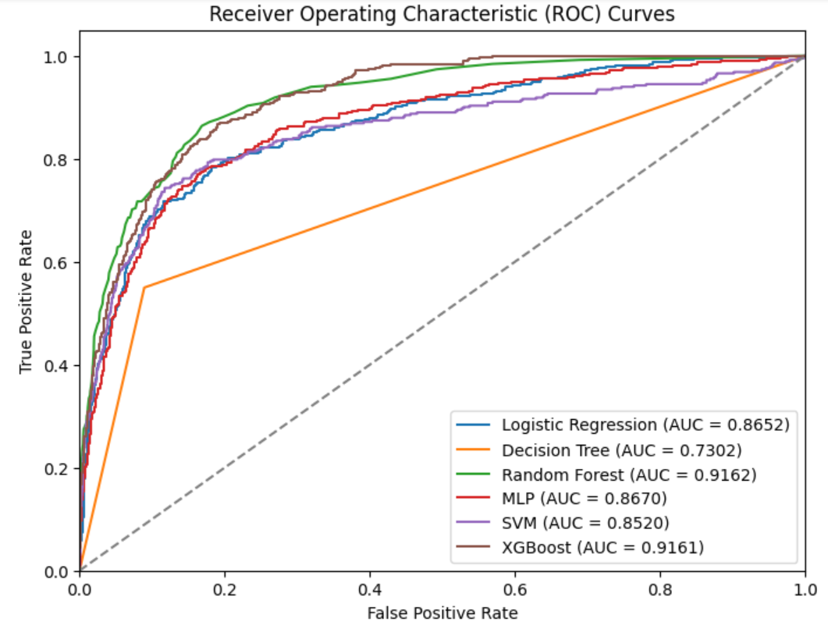

Roc curve
Top Performers:
Random Forest:
Highest accuracy (0.9006) and ROC-AUC (0.9158), best for distinguishing between potential buyers and non-buyers.
XGBoost: Excellent ROC-AUC (0.9161) but slightly lower performance in precision/recall for class
5
This Photo by Unknown Author is licensed under CC BY-NC-ND

Slide 9
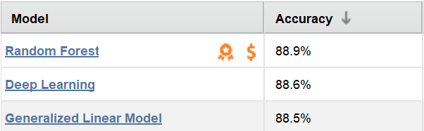
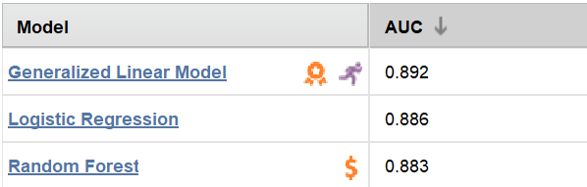
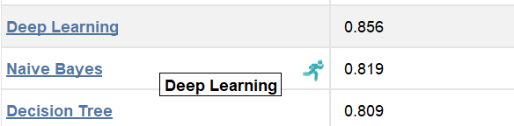
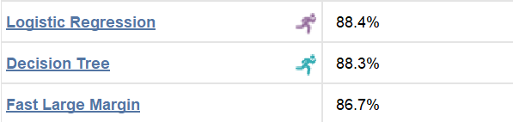

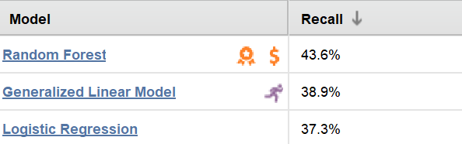
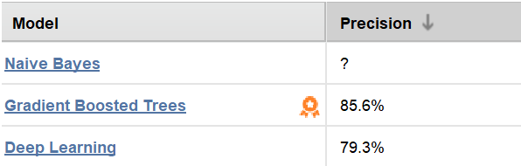
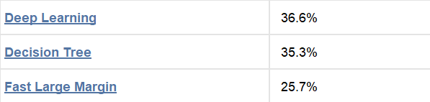
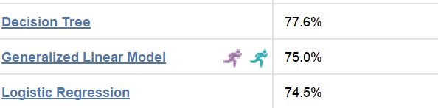


Rapid miner auto model
7

Slide 10
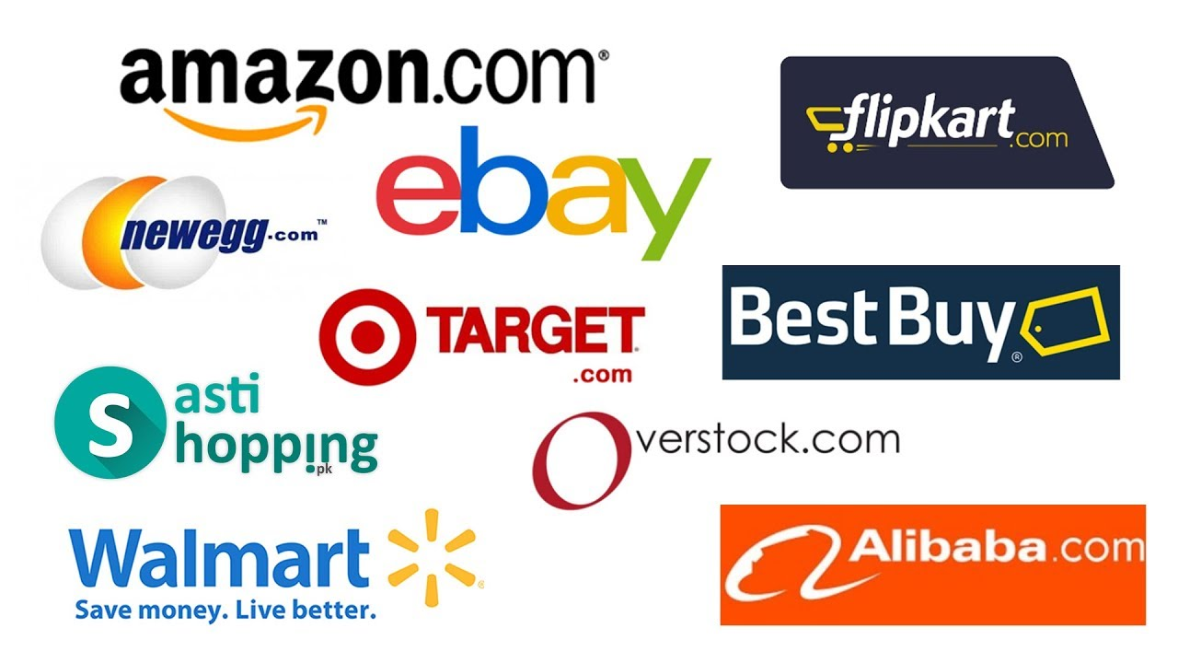

How do we use in real world
Real-Time Integration
Embed the trained model into the e-commerce system through REST APIs or scheduled batch processing.
Ensure seamless processing of user session data.
Session Scoring Process
While the user navigates, the model evaluates purchase intent dynamically.
Store predictions in a central database or push them directly to the site’s front-end.
Action Triggers
Activate personalized actions instantly, such as:
Exclusive discounts during the session
Custom product suggestions
Automated reminder emails for abandoned carts
5

Slide 11

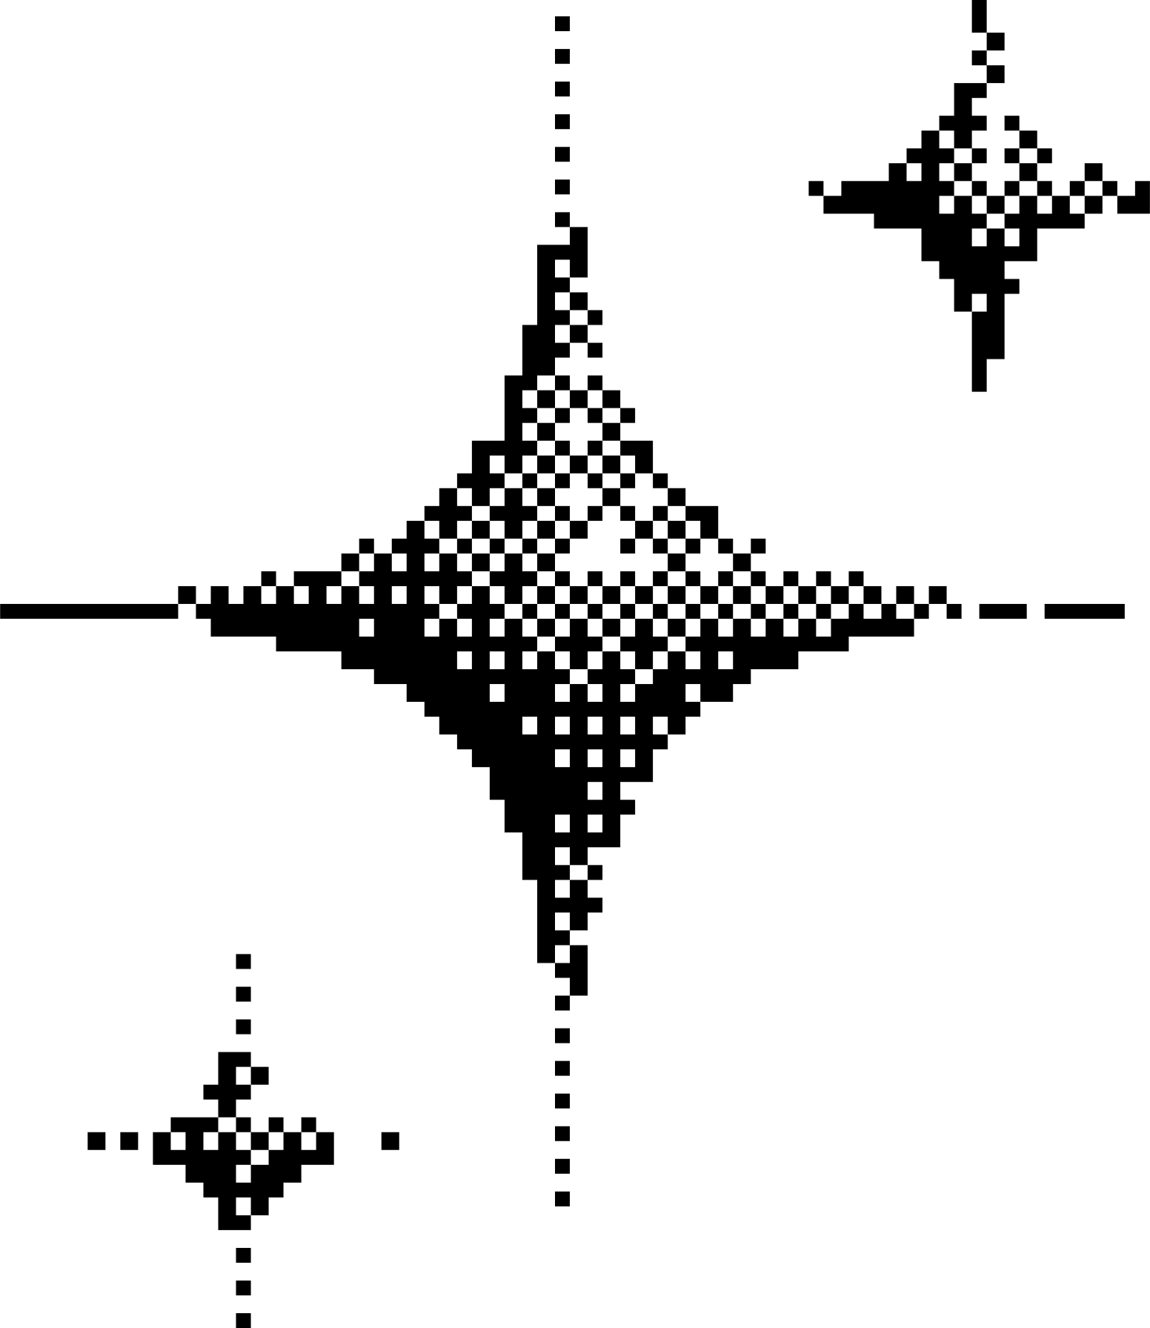
Thank you
6

